Slide 1

AMS 530: Final Project 4.4 Molecular Dynamics Energy Reduction
Amr Ibrahim

Slide 2

Table of contents
Problem statement
Goal
Setup
Program
General Design
Functions spotlight
Results
Discussion
Future direction

Slide 3
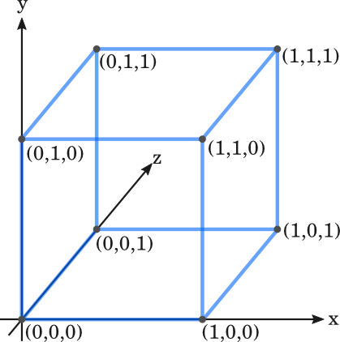
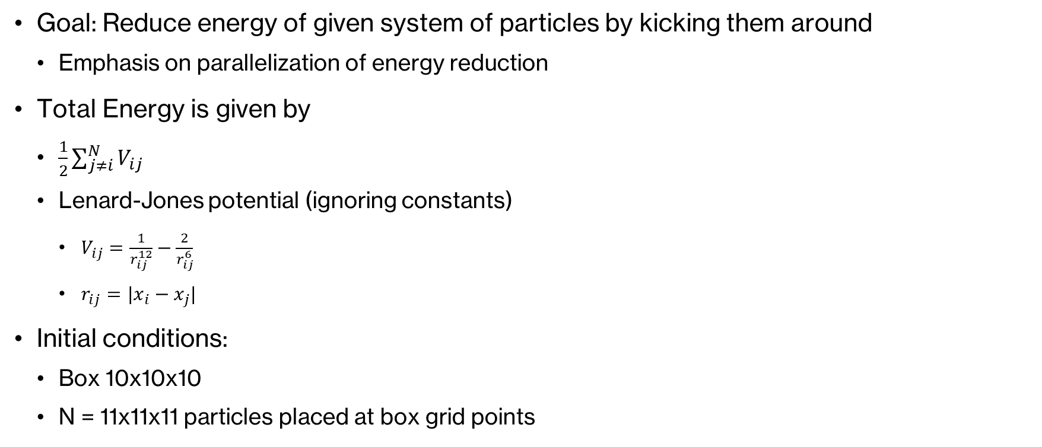
Problem Statement
Goal: Reduce energy of given system of particles by kicking them around
Emphasis on parallelization of energy reduction
Total Energy is given by
$\frac{1}{2}\sum_{j≠i}^{N}{V_{ij}}$
Lenard-Jones potential (ignoring constants)
$V_{ij}=\frac{1}{r_{ij}^{12}}−\frac{2}{r_{ij}^{6}}$
$r_{ij}=|x_{i}−x_{j}|$
Initial conditions:
Box 10x10x10
N = 11x11x11 particles placed at box grid points

Slide 4
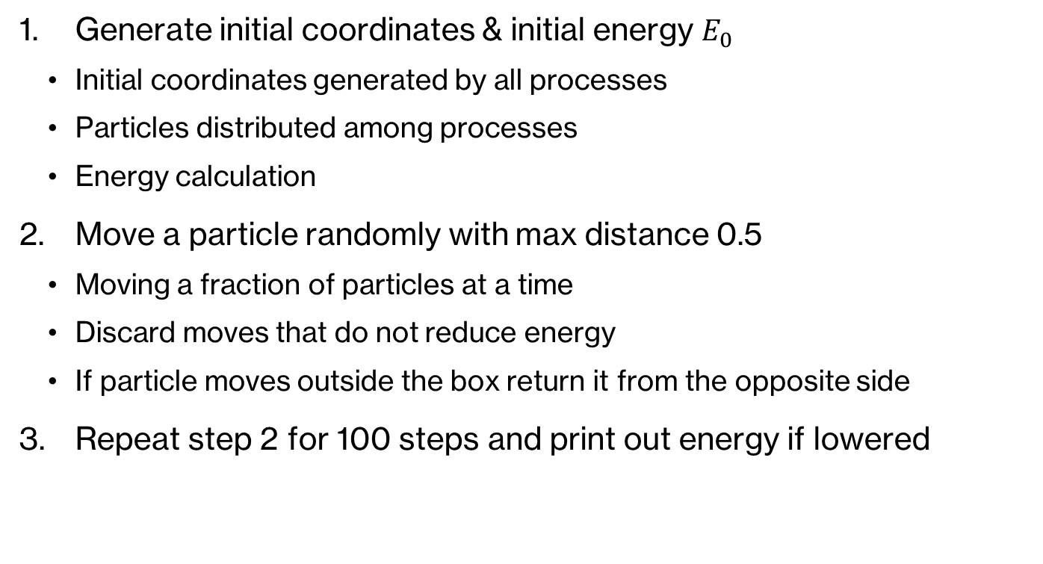
Program: General Design
Generate initial coordinates & initial energy $E_{0}$
Initial coordinates generated by all processes
Particles distributed among processes
Energy calculation
Move a particle randomly with max distance 0.5
Moving a fraction of particles at a time
Discard moves that do not reduce energy
If particle moves outside the box return it from the opposite side
Repeat step 2 for 100 steps and print out energy if lowered

Slide 5
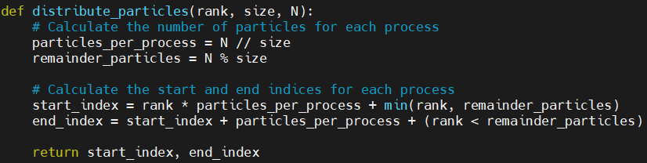
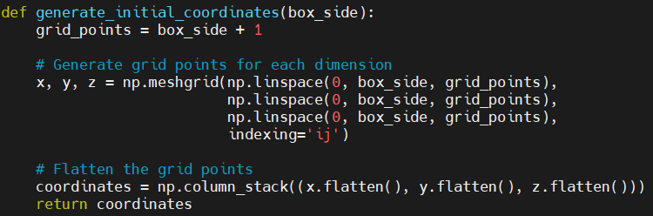
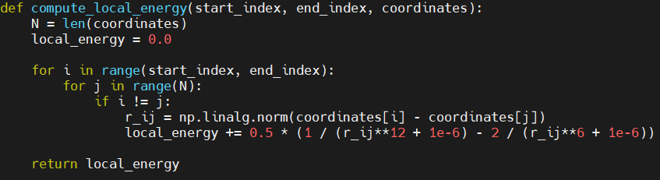
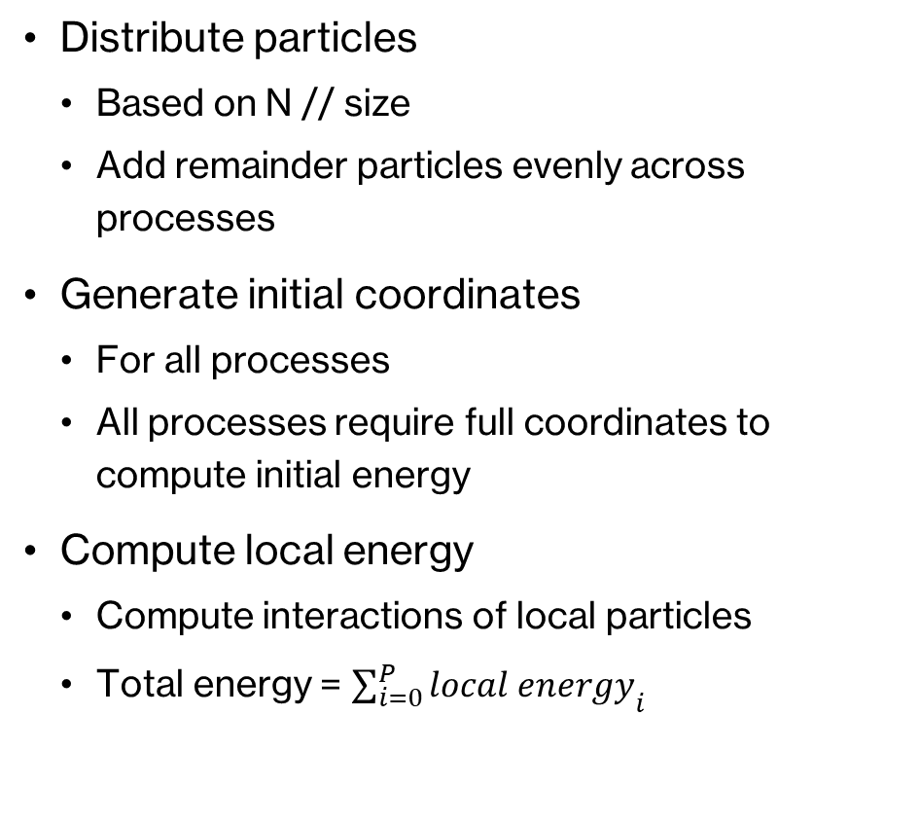
Program
Distribute particles
Based on N // size
Add remainder particles evenly across processes
Generate initial coordinates
For all processes
All processes require full coordinates to compute initial energy
Compute local energy
Compute interactions of local particles
Total energy = ${\sum_{i=0}^{P}{local energy}}_{i}$

Slide 6
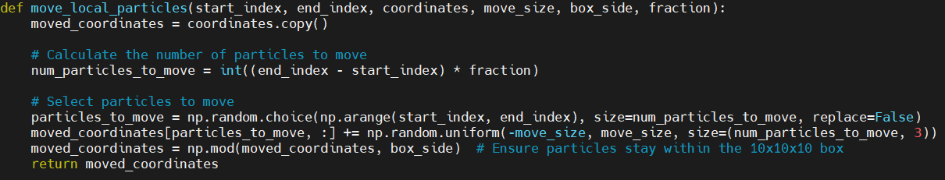
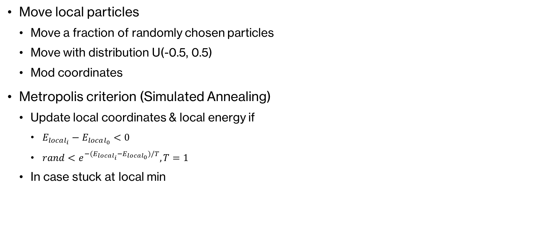
Program
Move local particles
Move a fraction of randomly chosen particles
Move with distribution U(-0.5, 0.5)
Mod coordinates
Metropolis criterion (Simulated Annealing)
Update local coordinates & local energy if
$E_{local_{i}}−E_{local_{0}}<0$
$rand<e^{−{(E}_{local_{i}}−E_{local_{0}})/T}, T=1$
In case stuck at local min

Slide 7
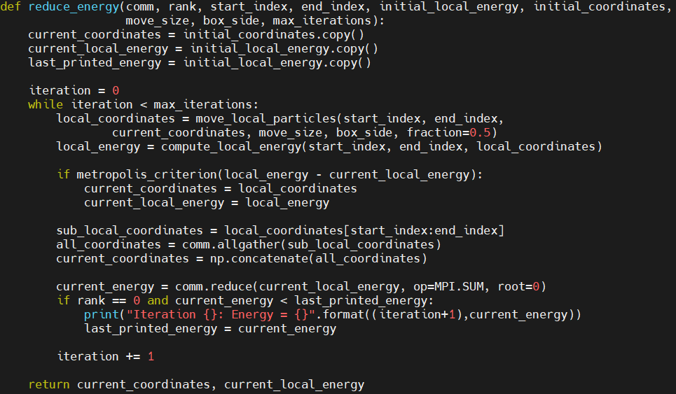
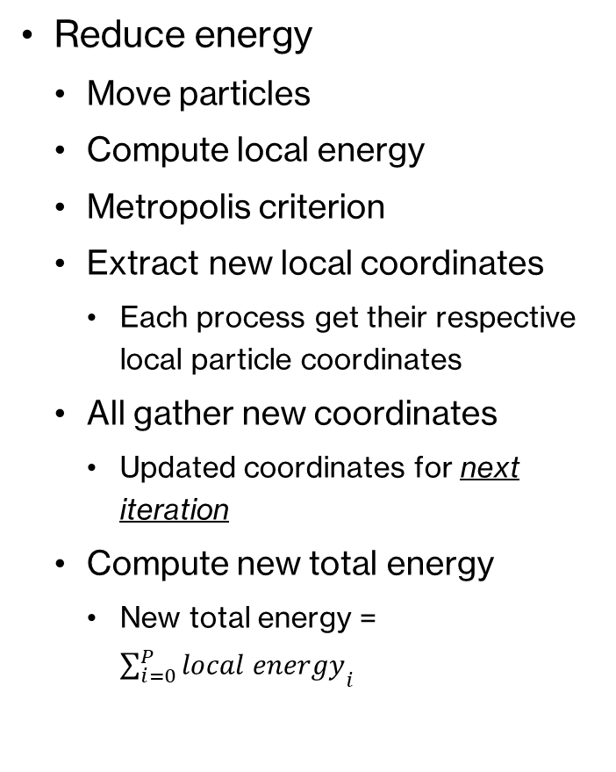
Program
Reduce energy
Move particles
Compute local energy
Metropolis criterion
Extract new local coordinates
Each process get their respective local particle coordinates
All gather new coordinates
Updated coordinates for next iteration
Compute new total energy
New total energy = ${\sum_{i=0}^{P}{local energy}}_{i}$

Slide 8
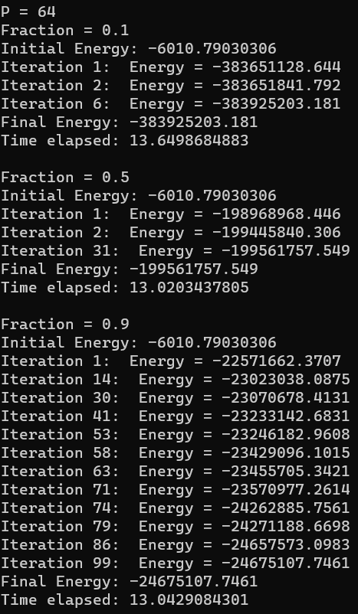
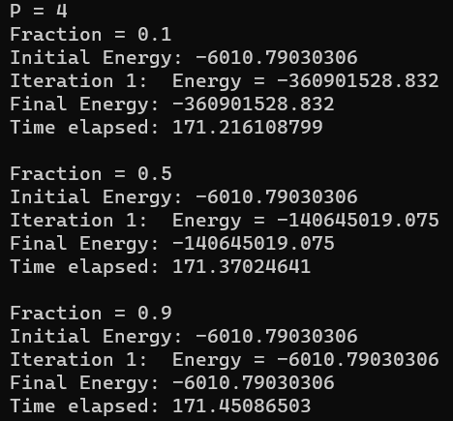
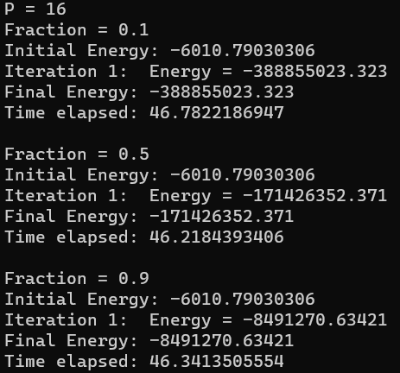
Results

Slide 9
Discussion
Energy reduction
1st step usually has a massive reduction
As fraction number increases reduction of energy is reduced
Among iterations reduction is small compared to 1st iteration
Time elapsed
Within each P, time elapsed variance is very small
As P increases time elapsed decreases

Slide 10
Future Direction
Decomposition
This project uses particle decomposition
Spatial + particle decomposition
Energy reduction
Method applied Monte Carlo
Gradient descent
Python’s scipy.optimize()

Slide 11
